Slide 1


Online Shoes Shop
Prepared By :
Roll No. :
Exam No. :
Guided By :
Submitted as :
Submitted To :
Rohit Prajapati
21BCA210
Mr. Shivendu .j. Pandya
Partial Fulfilment of BCA Degree
Shri D.N.Institute of Computer Applications,
Anand Sardar Patel University, V.V. Nagar

Slide 2



Tools
Front End :
Microsoft VB.NET WITH C#
Back End :
SQL Server

Slide 3
System Configuration
Componen | Minimum | Recommended
Processor | 2.5 gigahertz(GHZ) | Dual processor that are each 3 GHz or faster
RAM | 1GB | 2GB
Disk | NTFS file system-formatted partition with a minimum of 3GB of space. | NTFS file system-formatted partition with 3GB of free space plus adequate free space for your web sites
Drive | DVD Drive | DVD drive or the source copied to a local or network- accessible drive
Display | 1440 x 900 | 1440 x 900 or higher

Slide 4

Scope
The scope of an online shoes shop is to provide customers with a convenient and affordable way to purchase shoes online.
The online shoes shop will prove the best solution for the problems of current system.
It provides customers can shop for shoes from the comfort of their own homes, 24/7.
The online shop should make it easy for customers to find and purchase the shoes they want.
The scope of an online shoes shop can also be influenced by the target market.

Slide 5

Existing System
An online shoes shop system maintains all the records like particular’s information, customer information and reports.
Customer Can browse and search for shoes by brand, category, price, size, color, etc
Admin can manage the product catalog, process orders, and generate reports on sales, inventory, and customers.
Existing online shoes shop systems provide a convenient and efficient way for customers to purchase shoes online.

Slide 6

Need of Propose System
To improved customer satisfaction .
To improved efficiency to services .
Better inventory control .
Order management.
Customer support .
More efficient marketing .

Slide 7

System Features
The current system handles all stock activities and procedures manually.
Contact customer support for assistance with your order, product questions, or other issues.
View detailed information about each shoe, including images, descriptions, and reviews.
Customers can pay for their purchases using a variety of payment methods, such as Gpay or COD(Cash on Delivery) Methods

Slide 8
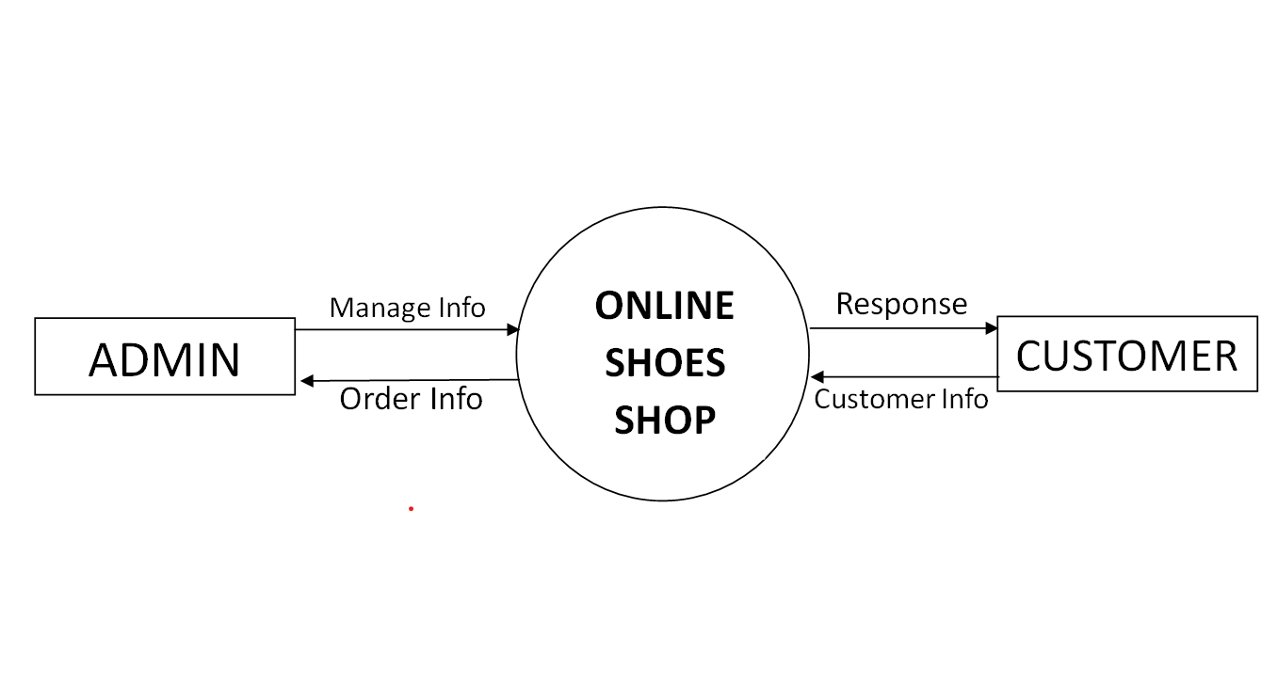
Data Flow Diagram
Context Level DFD :

Slide 9
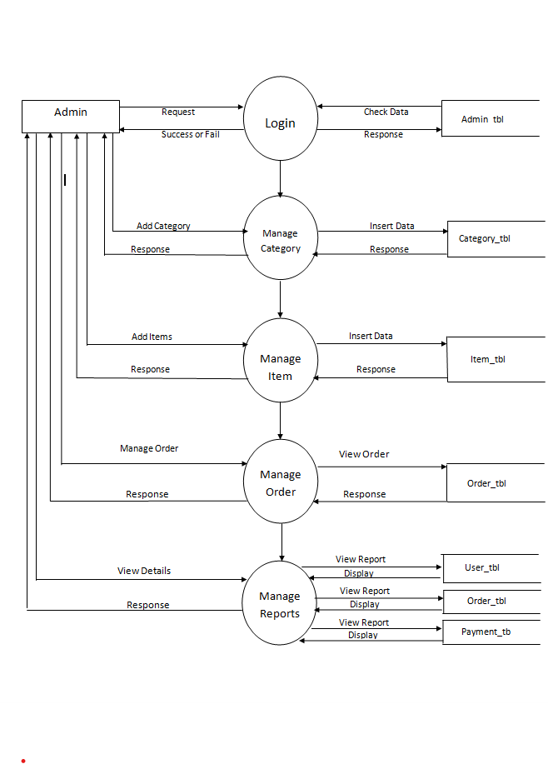
Zero Level DFD :
_
l

Slide 10
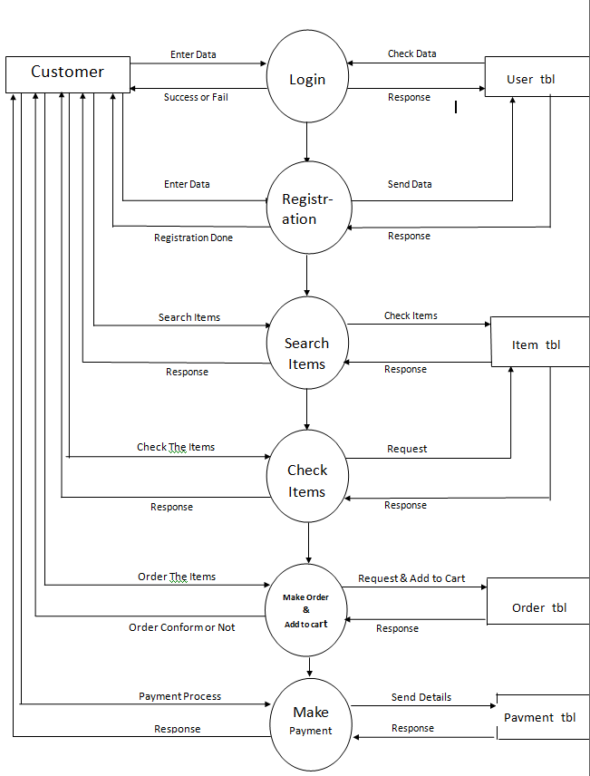
First Level DFD :
_
_
_
_

Slide 11
Database Layout
1) ADMIN (admin_login) :
Sr. No. | Field Name | Data Type | Size | Constraint | Description
1 | Userid | varchar | 50 |  | User Id
2 | password | varchar | 50 |  | Password

Slide 12
Database Layout
2) User LOGIN (log) :
Sr. No. | Field Name | Data Type | Size | Constraint | Description
1 | userid | Int |  | Primary Key | UserId
2 | password | varchar | 50 |  | Password

Slide 13
Database Layout
3) Category (cate) :
Sr. No. | Field Name | Data Type | Size | Constraint | Description
1 | Categoryid | Int |  | Primary Key | Category Id
2 | Cate_name | varchar | 50 |  | Category Name
3 | nu_items | Int |  |  | Number of Items

Slide 14
Database Layout
4) Registration (regtbl) :
Sr. No. | Field Name | Data Type | Size | Constraint | Description
1 | userid | Int |  | Primary Key | User Id
2 | name | nvarchar | 100 |  | Full Name
3 | Email | nvarchar | 50 |  | Email
4 | password | nvarchar | 50 |  | Password
5 | phone | numeric | 18,0 |  | Phone Number
6 | gender | nchar | 10 |  | Gender
7 | pincode | Int |  |  | Pincode
8 | state | nvarchar | 50 |  | State
9 | city | nvarchar | 50 |  | City
10 | address | nvarchar | 200 |  | Address

Slide 15
Database Layout
5) Add Admin :
Sr. No. | Field Name | Data Type | Size | Constraint | Description
1 | userid | Int |  | Primary Key | UserId
2 | password | varchar | 50 |  | Password

Slide 16
Database Layout
6) ORDER (ordertbl):
Sr. No. | Field Name | Data Type | Size | Constraint | Description
1 | userId | Int |  | Primary Key | Id
2 | ordercode | varchar | 20 |  | Order Code
3 | name | varchar | 30 |  | Name
4 | address | varchar | 100 |  | Aaddress
5 | state | nchar | 10 |  | State
6 | city | Int |  |  | City
7 | qty | int | 50 |  | Quantity
8 | order_t | varchar | 50 |  | Order Time
9 | pincode | varchar | 50 |  | Pin code

Slide 17
Database Layout
7) PAYMENT (pement_tbl) :
Sr. No. | Field Name | Data Type | Size | Constraint | Description
1 | pay_ty | varchar | 50 | Primary key | Payment Type
2 | userid | Int | 10 |  | User Id
3 | pay_code | varchar | 50 |  | Payment code
4 | t_ amount | Int | 50 |  | Total Amount

Slide 18
Database Layout
8) Item(pement_tbl) :
Sr. No. | Field Name | Data Type | Size | Constraint | Description
1 | Pid | Int |  | Primary key | Product Item Id
2 | pname | Varchar | 50 |  | Item Name
3 | pimg | Varchar | Max |  | Item Image
4 | price | Int |  |  | Price
5 | disc | Varchar | 100 |  | Item Description

Slide 19
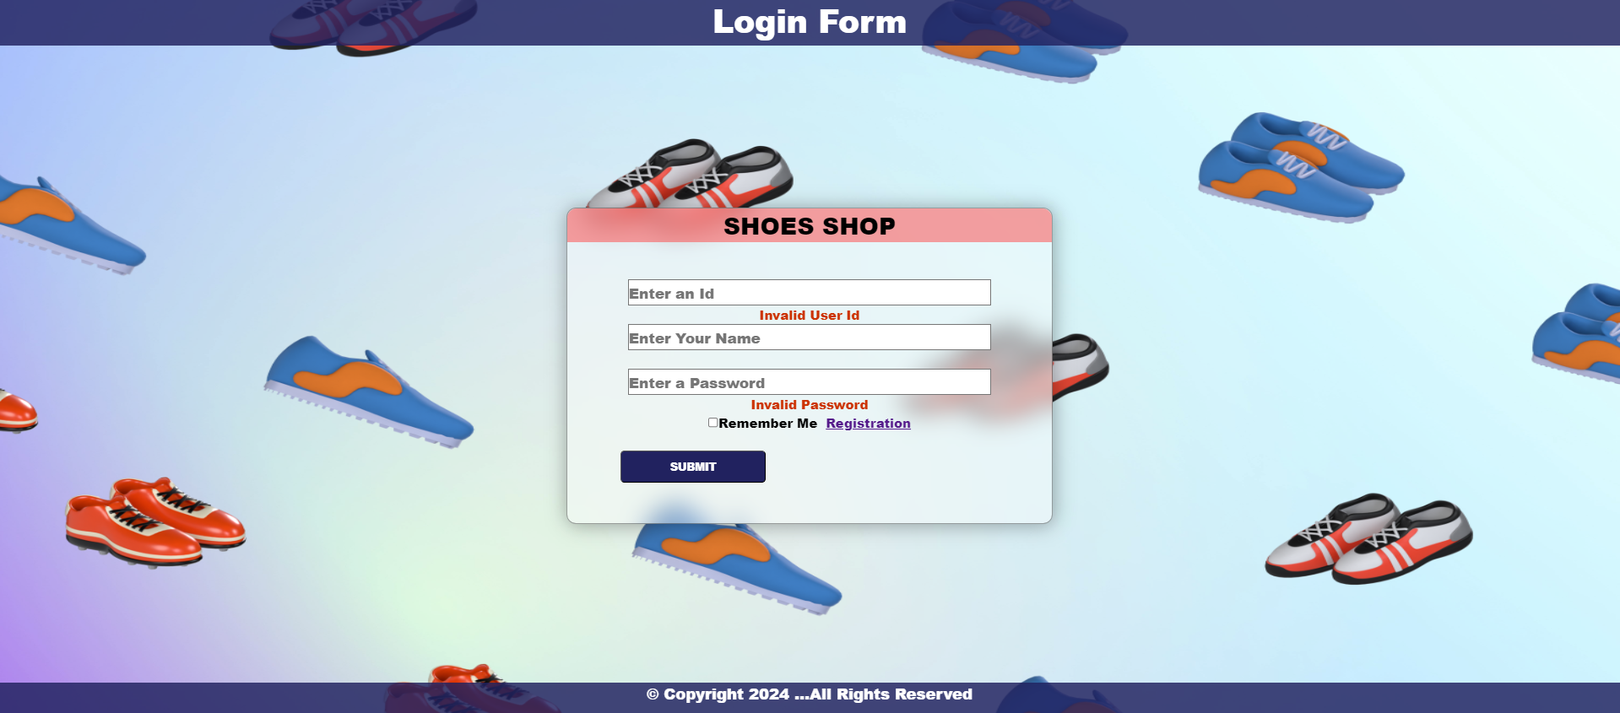
Design of Input Screen
Customer Login Page

Slide 20
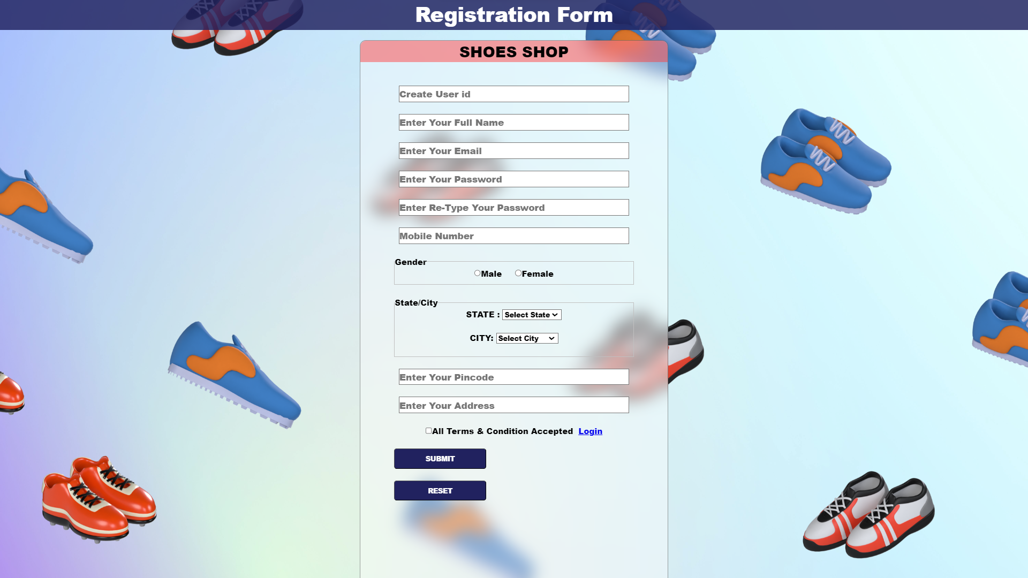
New User Registration

Slide 21
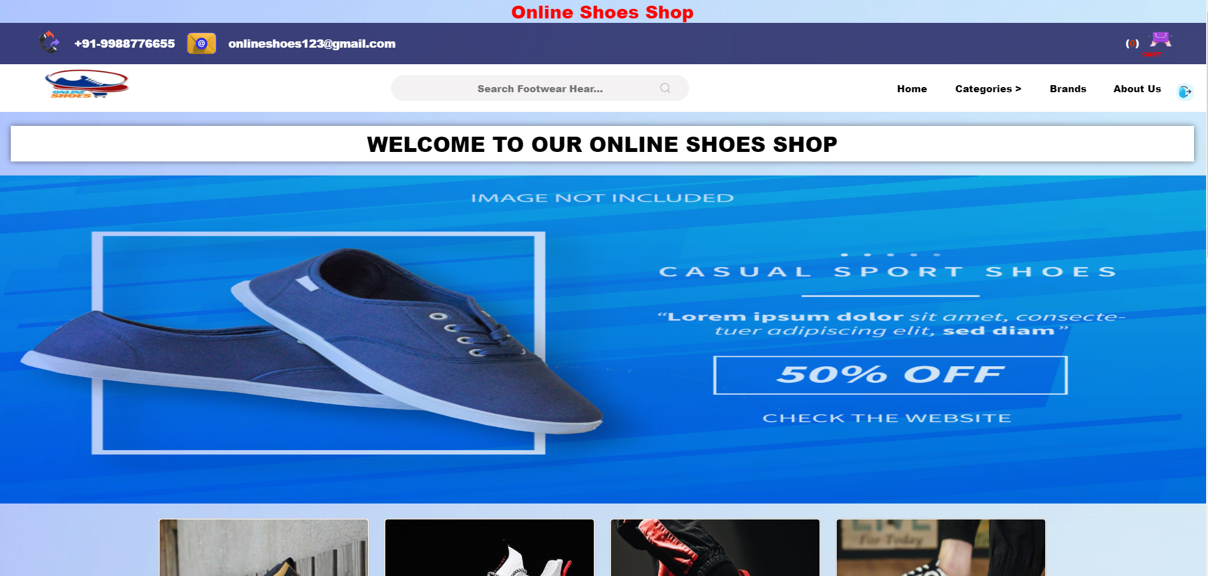
HOME PAGE

Slide 22
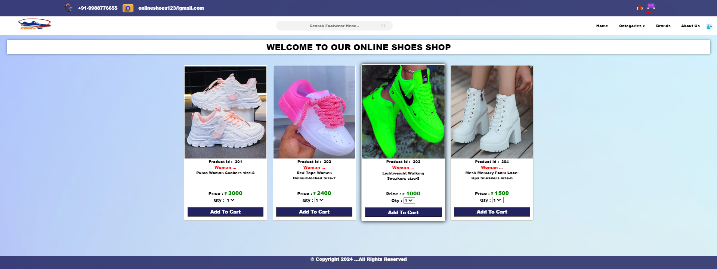
Woman Shoes PAGE

Slide 23
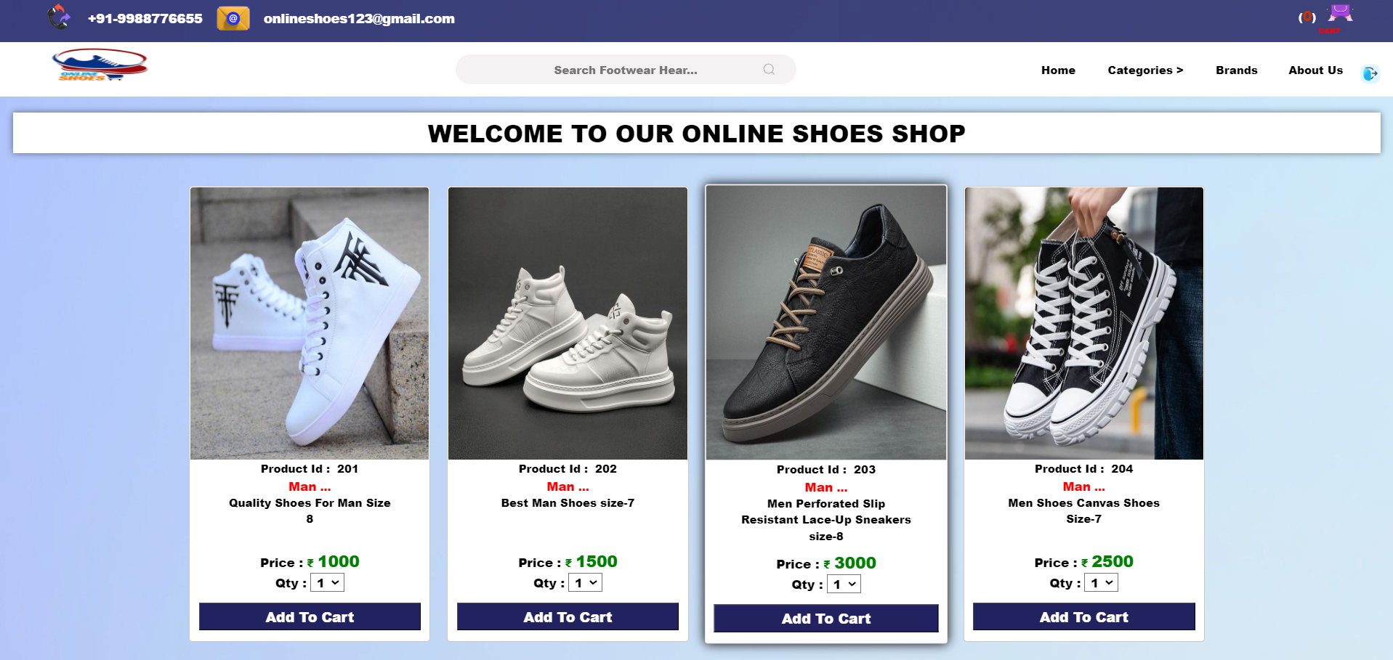
Man Shoes PAGE

Slide 24
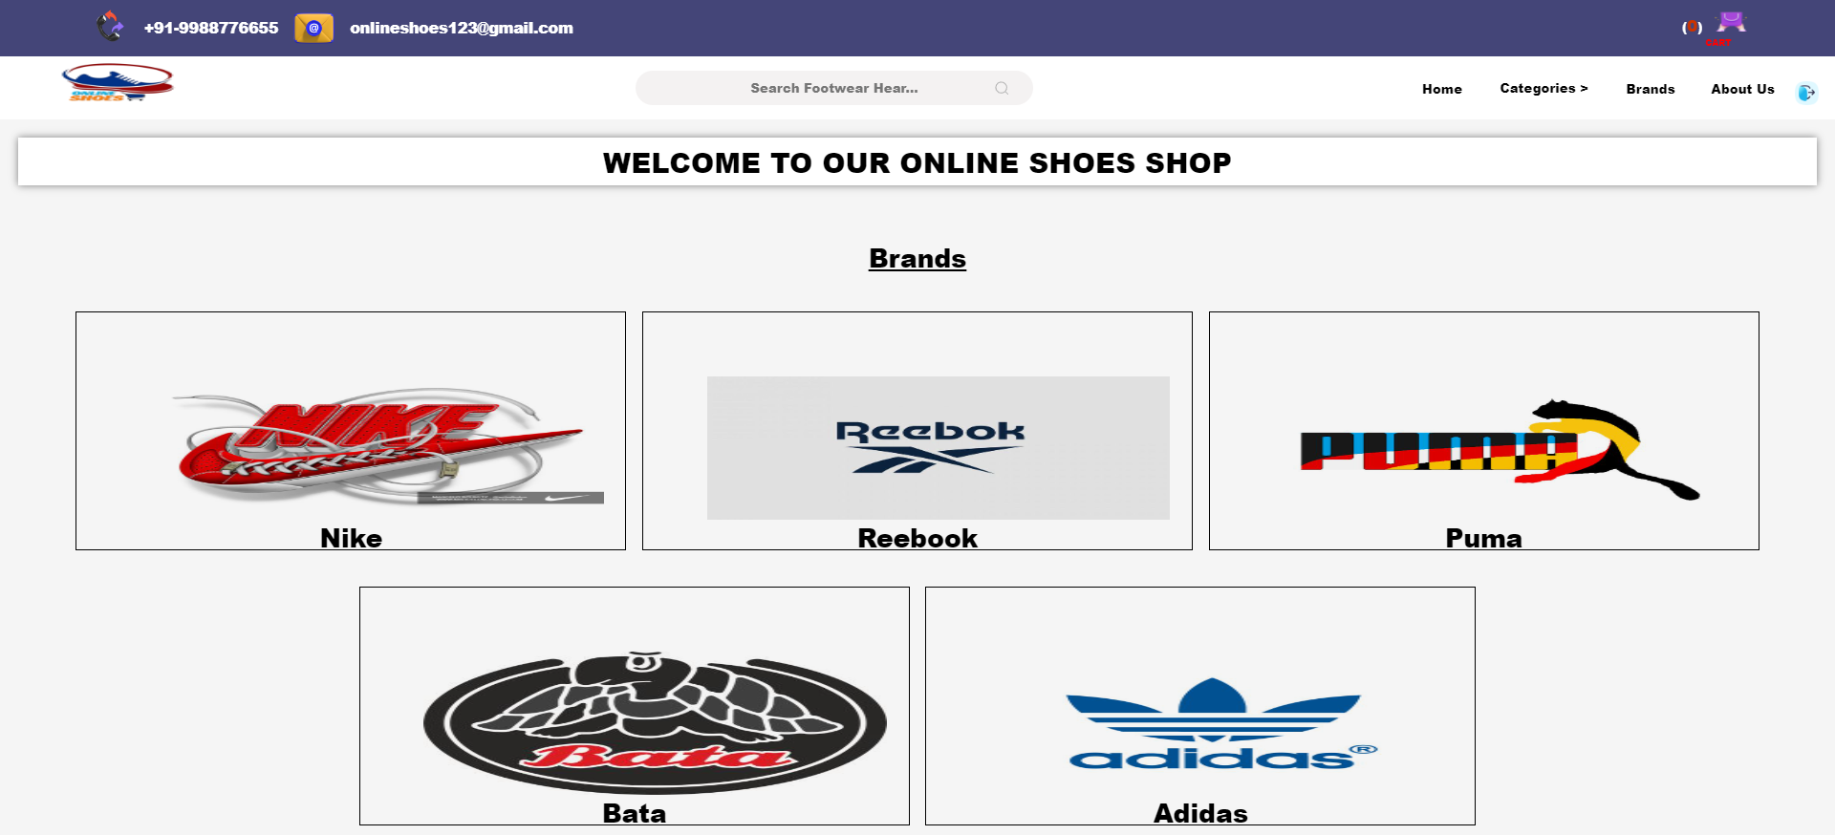
BRANDS PAGE

Slide 25
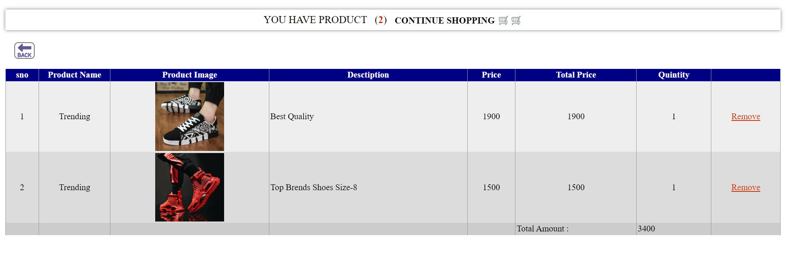
CART

Slide 26
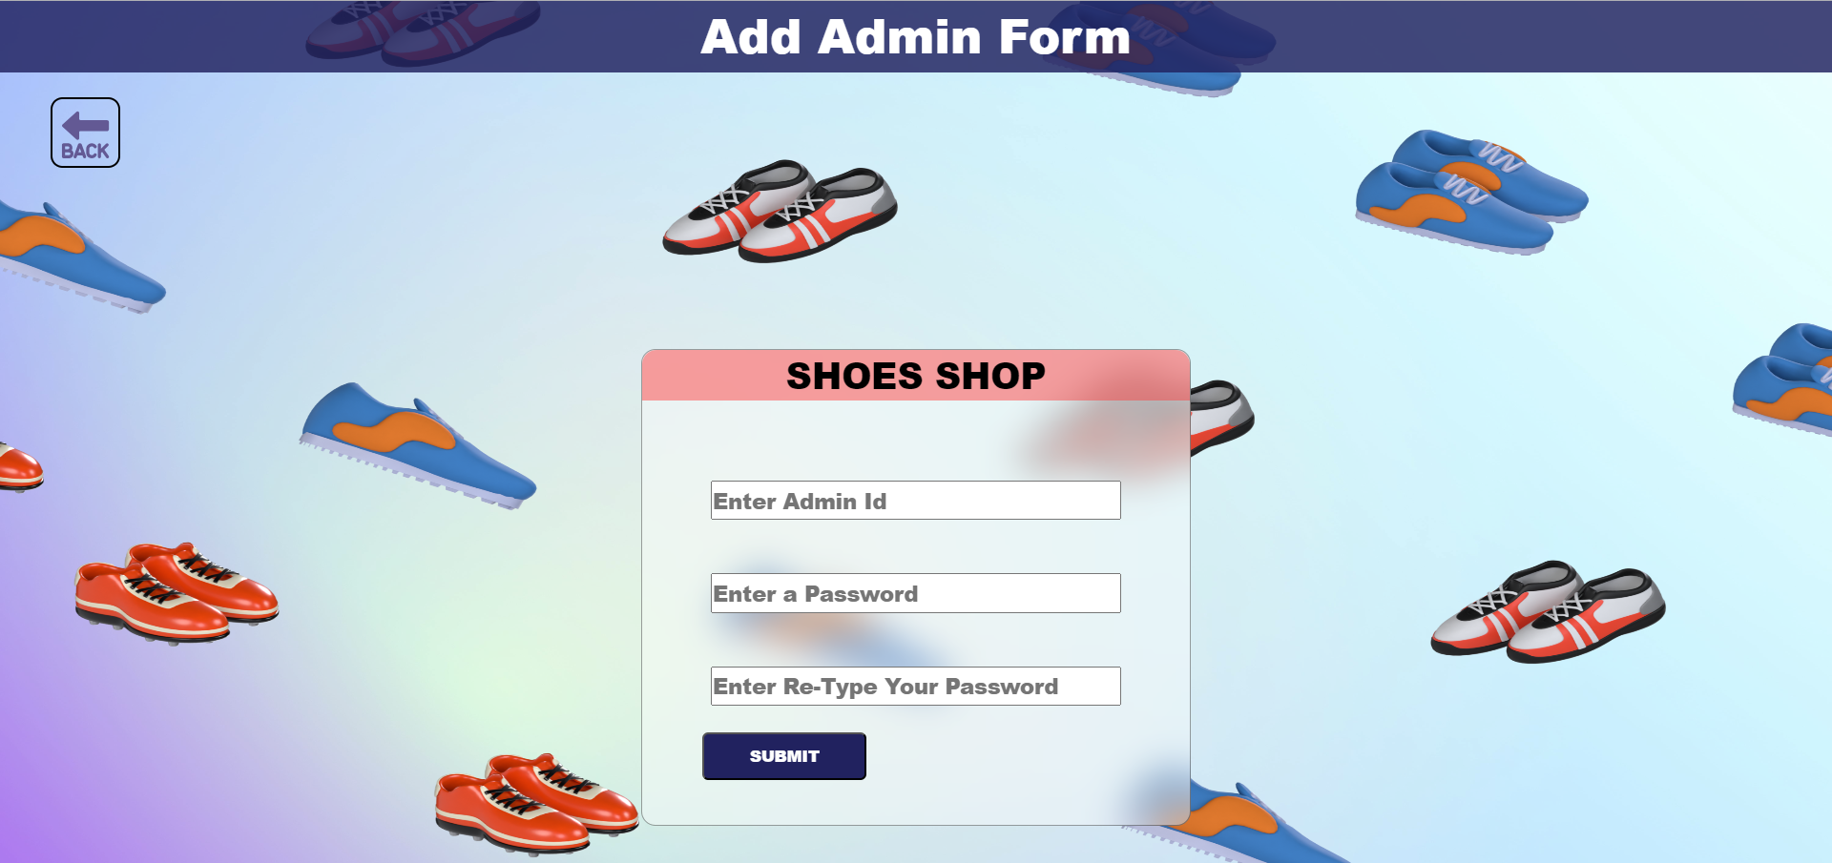
ADD ADMIN

Slide 27
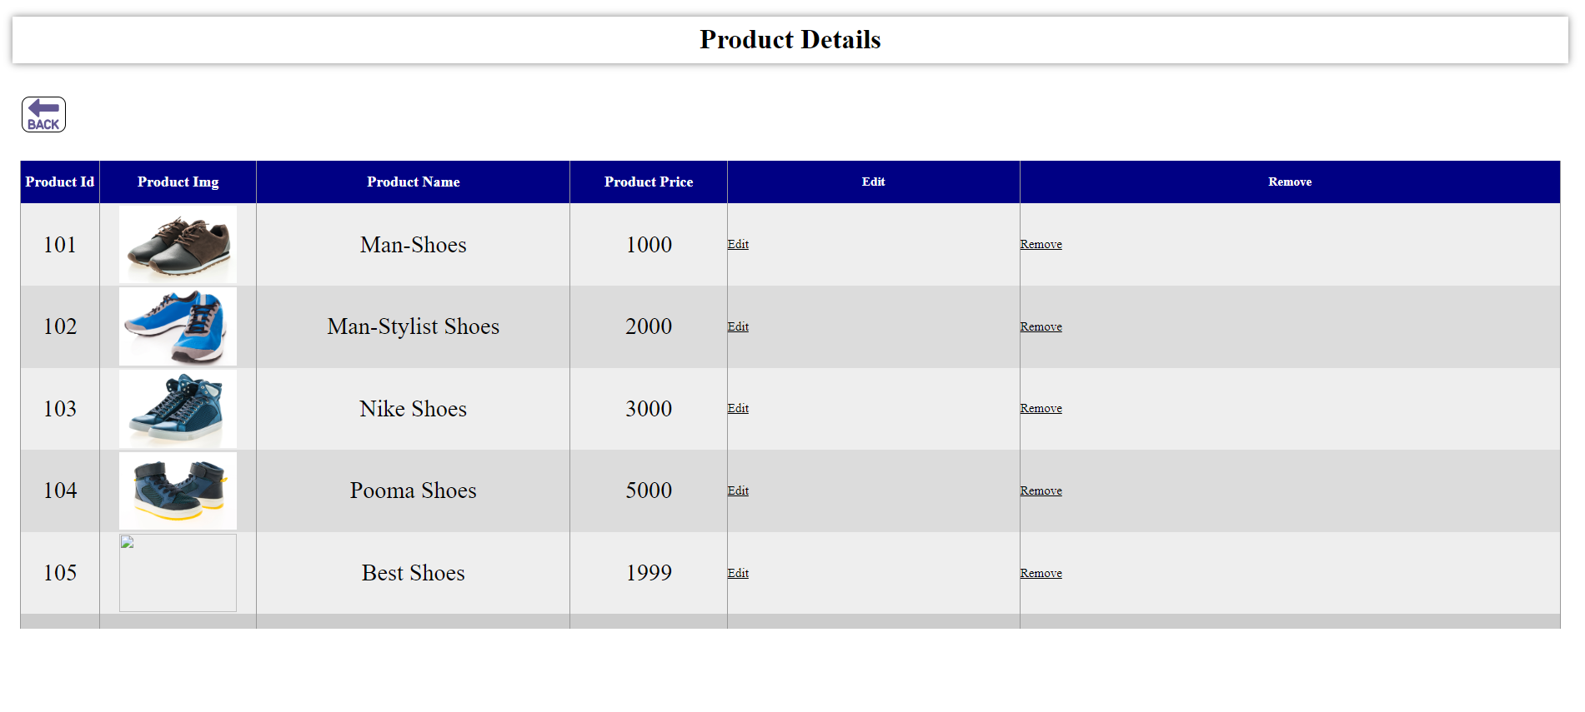
ADMIN MANAGE PRODUCTS CATEGORIES

Slide 28
Limitation
Sizes may very between brands and style , so Ii’s important to check the size chart before making a purchase .
Online shoes shop do not allow customers to try on shoes before purchasing them .
Online shoes shops may have a limited selection of shoes compared to physical store .
If we have an argent need of shoes for party and occasion , then online shopping will not work .

Slide 29
Conclusion
The online shoes shop industry is a growing and competitive market. Online shoes shops offer a number of advantages over traditional brick-and-mortar stores, including convenience, selection, price, and ease of comparison shopping. To be successful in this market, online shoes shops need to focus on providing a positive customer experience, including a wide selection of high-quality shoes, competitive prices, and a generous return policy.

Slide 30
References
System analysis and design By Elias Award .
System analysis and design by James A. Senn by TataMacGrow Hill.
Software Engineering By Pankaj jalotepublished by pressman .
Visual Basic: The complete references .

Slide 31

Thank you
By Rohit Prajapati

